Slide 1

Chapter 14 – Ecology and habitat study
The Biological World – Systems and Interactions

Slide 2


Objectives:
To give students an understanding of ecology
To help students understand the difference between a habitat and an ecosystem
To ensure that students know how to carry out a habitat study
To help students find examples of adaptation, competition and interdependence in the habitat studied
To help students appreciate how matter and energy flow through ecosystems

Slide 3
Keywords:
Ecosystem
Community
Ecology
Niche
Biotic
Habitat
Abiotic
Adaptation
Competition
Interdependence
Frequency

Slide 4

14.1 What is ecology?

Slide 5
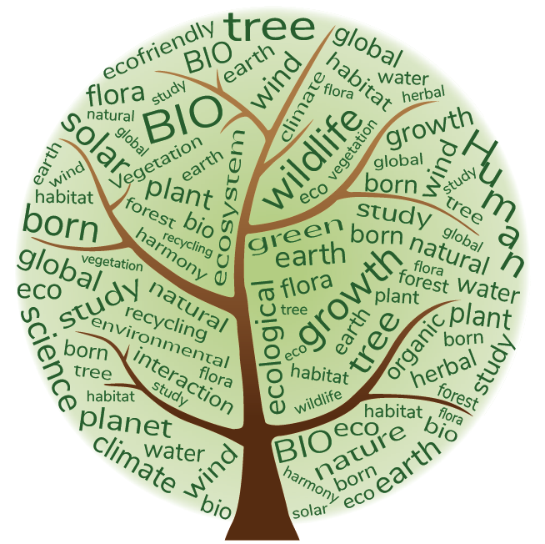
What is ecology?
Ecology is the branch of biology that studies how organisms interact with one another and with their physical surroundings (their environment).

Slide 6
14.2 Populations, communities, habitats and ecosystems

Slide 7
Populations, communities, habitats and ecosystems
A population of organisms is made up of members of the same species in an area.
A community of organisms is made up of a combination of different populations in an area.
Within a community, organisms all have a unique niche or role that they fill to keep the community balanced and stable.

Slide 8
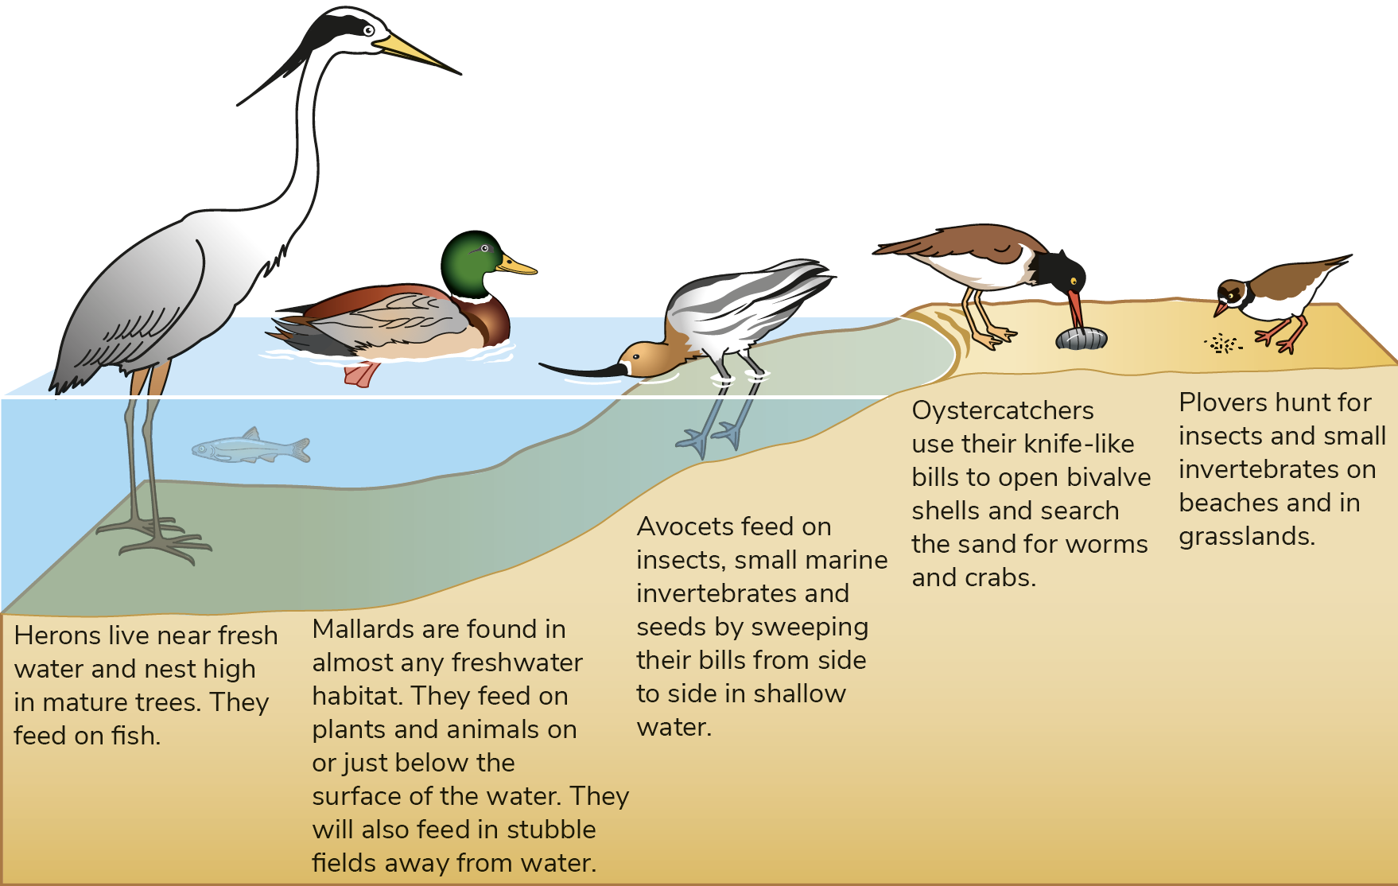
Populations, communities, habitats and ecosystems
The ecological niche of a species is its role in a community, how it fits in and how it interacts with other organisms.
Different species within a community occupy different niches.

Slide 9
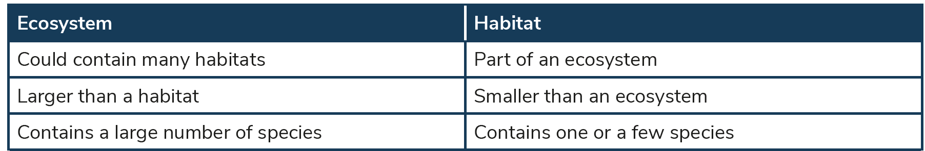
Populations, communities, habitats and ecosystems
A habitat is the place where a particular organism lives.
An ecosystem is a community of living organisms that interact with each other in a particular environment.

Slide 10
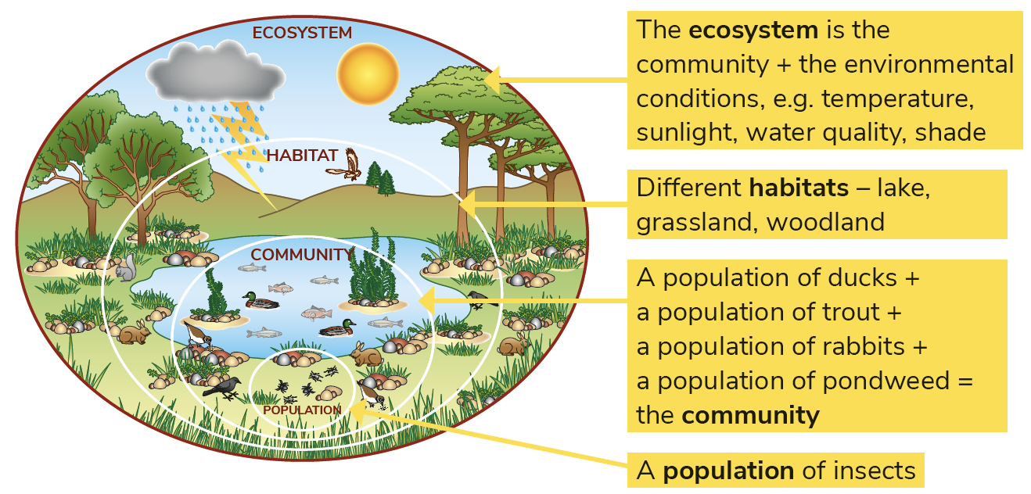
Populations, communities, habitats and ecosystems

Slide 11
14.3 Energy flow in an ecosystem

Slide 12
Energy flow in an ecosystem
The energy needed for an ecosystem to function comes mostly from sunlight.
Light energy is trapped in the ecosystem during the process of photosynthesis.
Producers (green plants) use light energy during photosynthesis to create chemical energy (food).
Consumers eat plants and other animals to get energy.

Slide 13
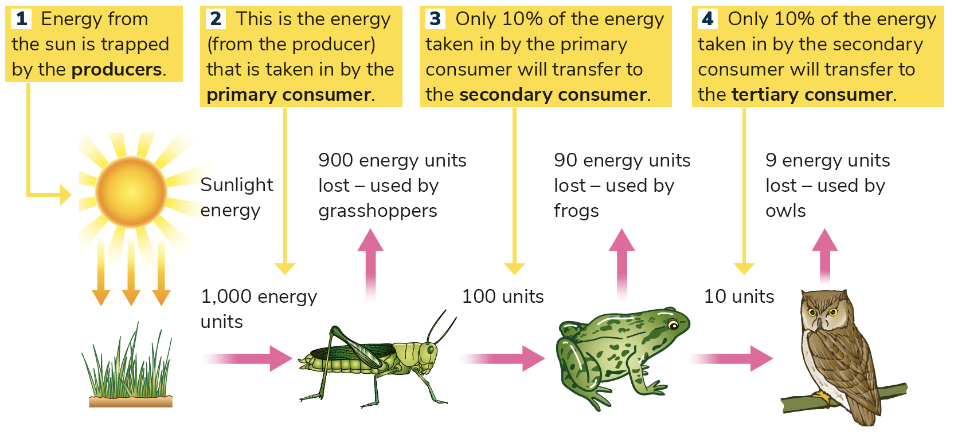
Energy flow in an ecosystem

Slide 14
Energy flow in an ecosystem
Decomposers make sure that dead matter is broken down and recycled into the feeding chains.
Types of consumers include:
Herbivores
Carnivores
Omnivores

Slide 15
Trophic levels
A trophic level is the position that an organism occupies in a food chain.
Producers occupy the first trophic level of the food chain.
Primary consumers occupy the second trophic level.
Secondary consumers occupy the third trophic level.
Tertiary consumers occupy the fourth trophic level.

Slide 16
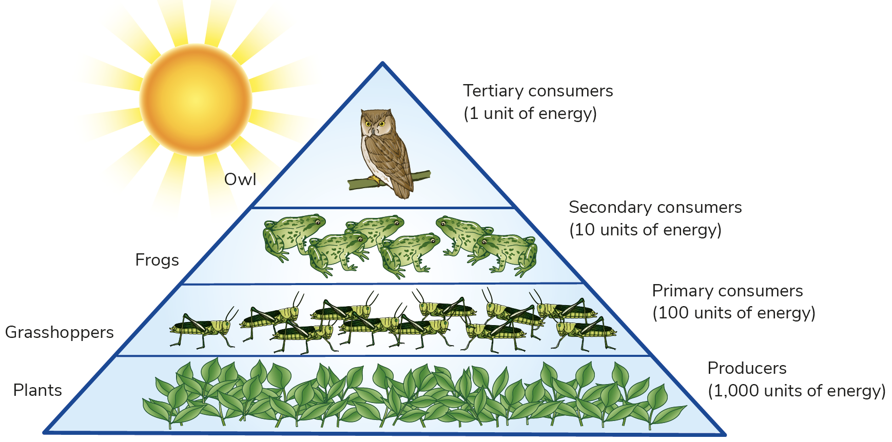
Energy pyramid
An energy pyramid shows the relative numbers of organisms at each trophic level needed to sustain an ecosystem.
Q: What trophic level is the owl at in the food chain?
Q: What trophic level are the grasshoppers at in the food chain?

Slide 17
14.4 Flow of matter in an ecosystem

Slide 18
Flow of matter in an ecosystem
Certain matter is cycled between the living and non-living parts of the ecosystem.
The carbon cycle and the water cycle will be covered in detail in Chapter 39.
Nitrogen is also cycled through ecosystems from nitrogen gas in the air, nitrates in the soils, plant protein and animal protein and back into atmospheric nitrogen again.

Slide 19
14.5 Habitat study

Slide 20
Why study a habitat?
Gives us information about the different lifeforms that live in it
Helps us understand how different animals and plants are adapted to their habitats
Helps us understand the impact of human actions
Helps us identify the factors that can lead to harmful changes in the habitat
Helps us to protect the habitat from harmful conditions

Slide 21
14.6 Steps in a habitat study

Slide 22
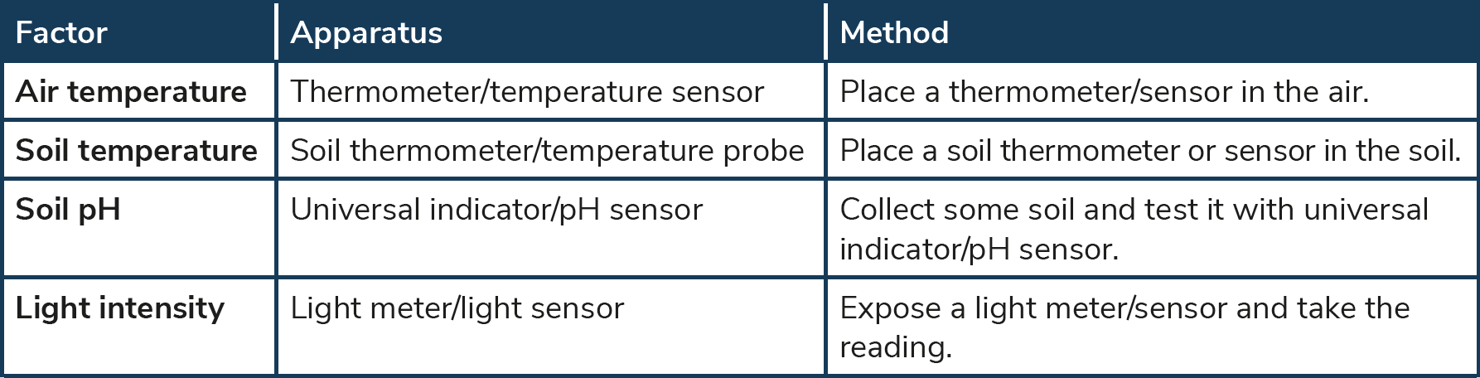
Steps in a habitat study
Identify a habitat, for example grassland.
Section off the area you will study within the habitat.
Measure some factors affecting the habitat (examples below).

Slide 23
Steps in a habitat study
Abiotic factors are the non-living things that affect organisms in their habitats, for example air temperature, soil temperature, soil pH and light intensity.
Biotic factors are the living things that affect other living things, for example what organisms each organism feeds on, competition, interdependence and adaptation.

Slide 24
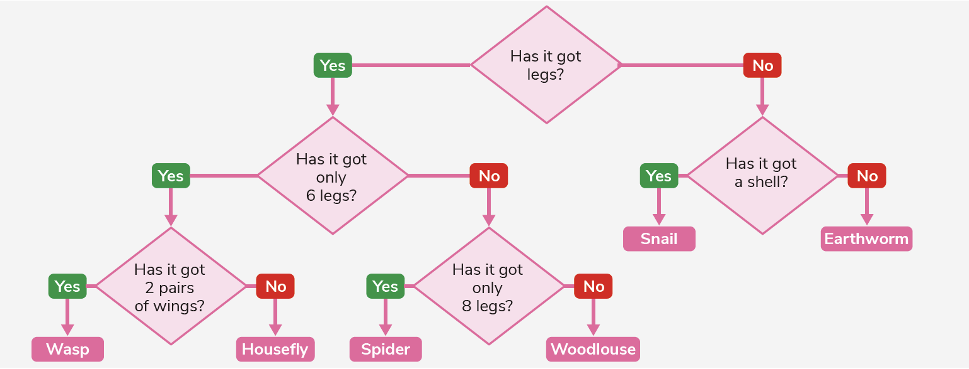
Steps in a habitat study
4. Identify the producers. (A key can be used for identification.)
5. Identify the consumers. (A key can be used for identification.)

Slide 25
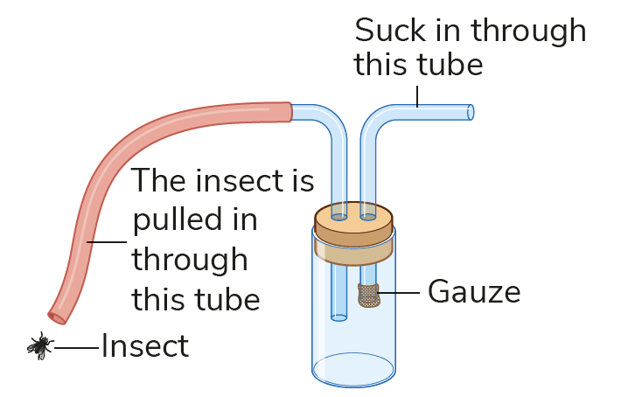
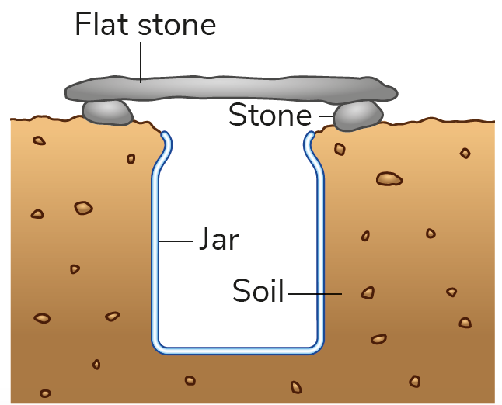
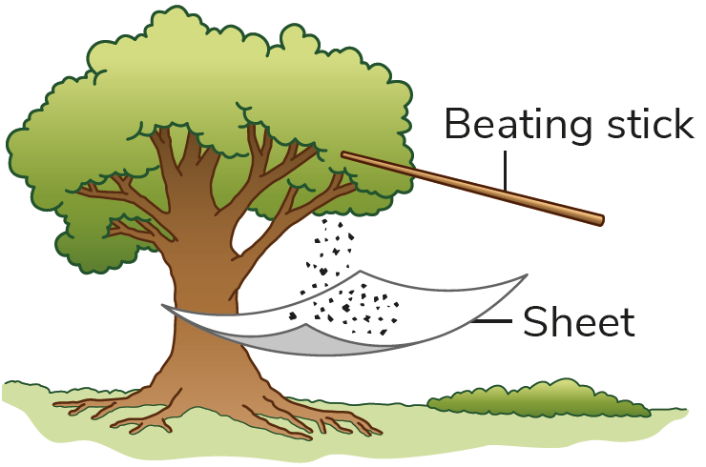
Steps in a habitat study
Certain apparatus can be used to capture animals and identify them. Examples below show a pooter, beating tray and pitfall trap.

Slide 26
Steps in a habitat study
Identify the decomposer. (A key can be used for identification.)
Note the adaptations plants and animals have to help them survive in the habitat.
Note examples of competition from the habitat. Competition is the interaction between members of the same species or members of different species for resources that are in short or limited supply.

Slide 27
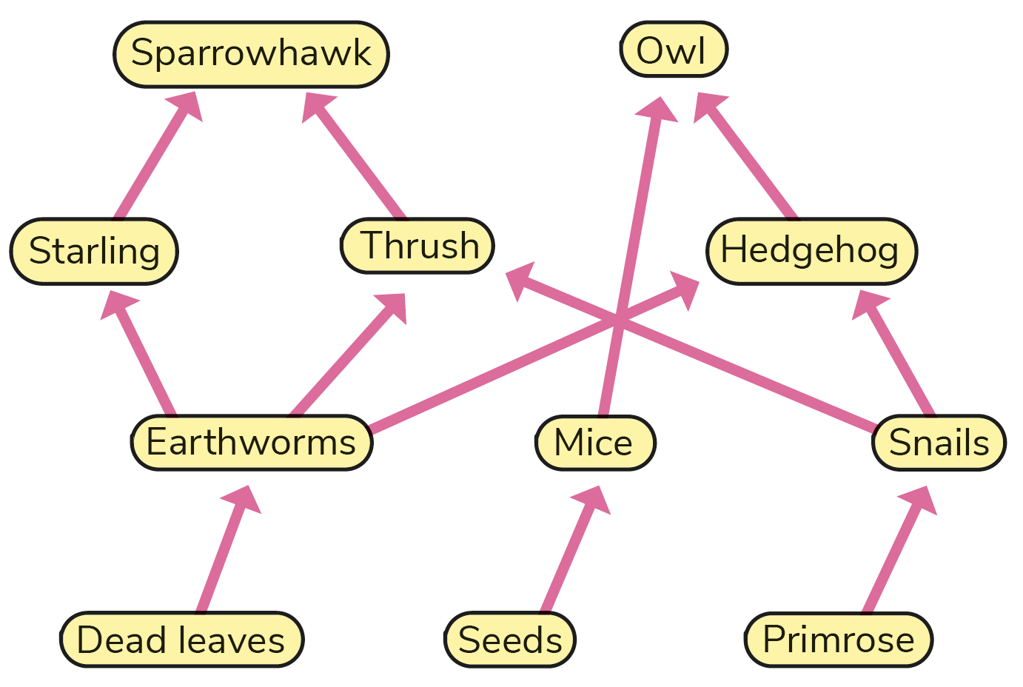
Steps in a habitat study
Note examples of interdependence from the habitat. Interdependence is the way one thing relies on another.

Slide 28
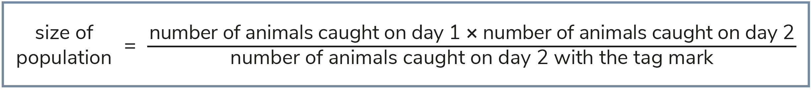
Steps in a habitat study
Counting populations – frequency is the percentage chance of finding a particular organism in one throw of a quadrat.
For plant populations, a quadrat study is carried out.
For animal populations, a ‘capture/recapture’ method is carried out. The formula for calculating the population size is below.

Slide 29
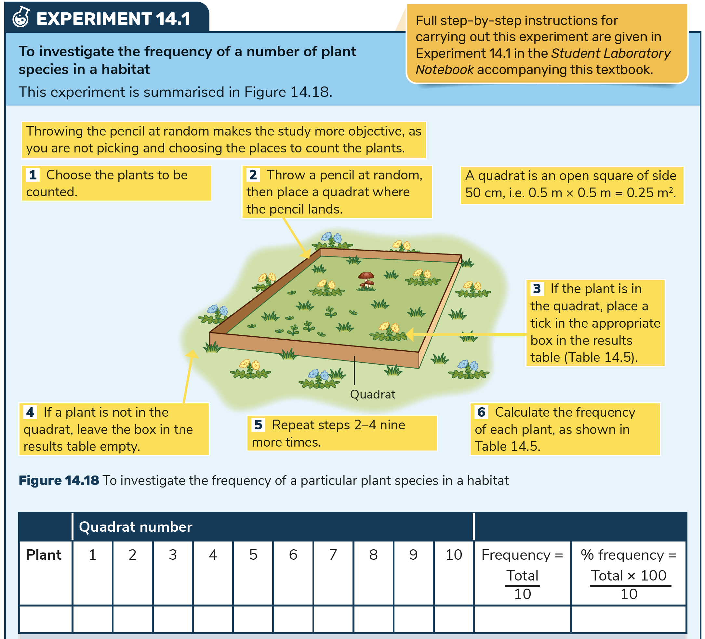

Slide 30
Learning outcomes: Now I am able to…
Tick
Discuss the importance of ecology.
Explain the difference between an ecosystem and a habitat.
Distinguish between a community and a population.
Identify adaptation, competition and interdependence in a habitat.
Measure the frequency of a plant species in a habitat.

Slide 31


